Slide 1
Computer vision
Raghu Prasad K S
www.kaushalya.tech
9845547471

Slide 2
Introduction
Raghu Prasad – BE, MS
Total of 23 years of experience
7 years as a lecturer in Engineering College
16 Years into IT
Worked with companies like CISCO,CSC,ICICI,First Apex – NTT Data
Currently into Corporate training and consultancy
Worked with corporates and public sector
Technologies – Java,Python,Web technologies,Java Script technologies (MEAN stack),IOT,Test Automation – Selenium,JMeter

Slide 3
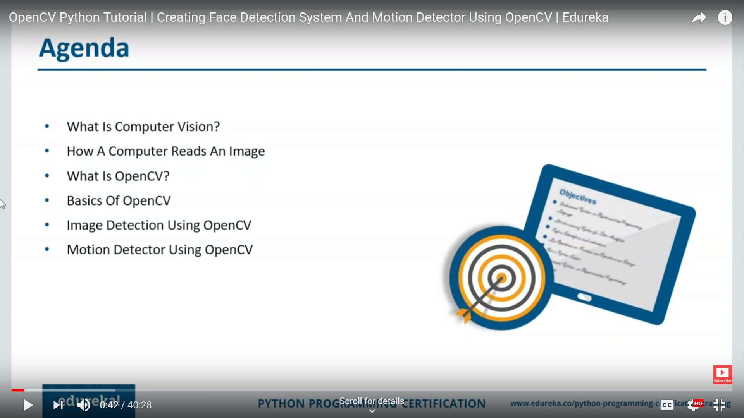
Computer Vision - Agenda

Slide 4
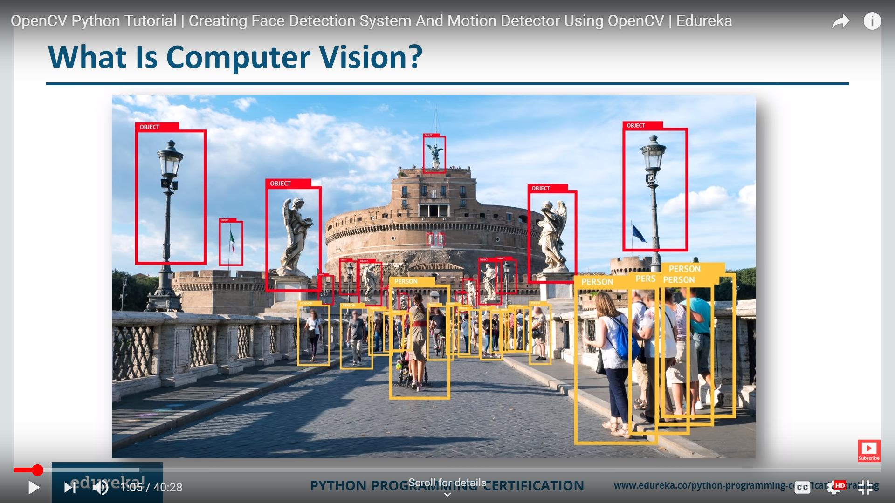
Computer Vision - What

Slide 5
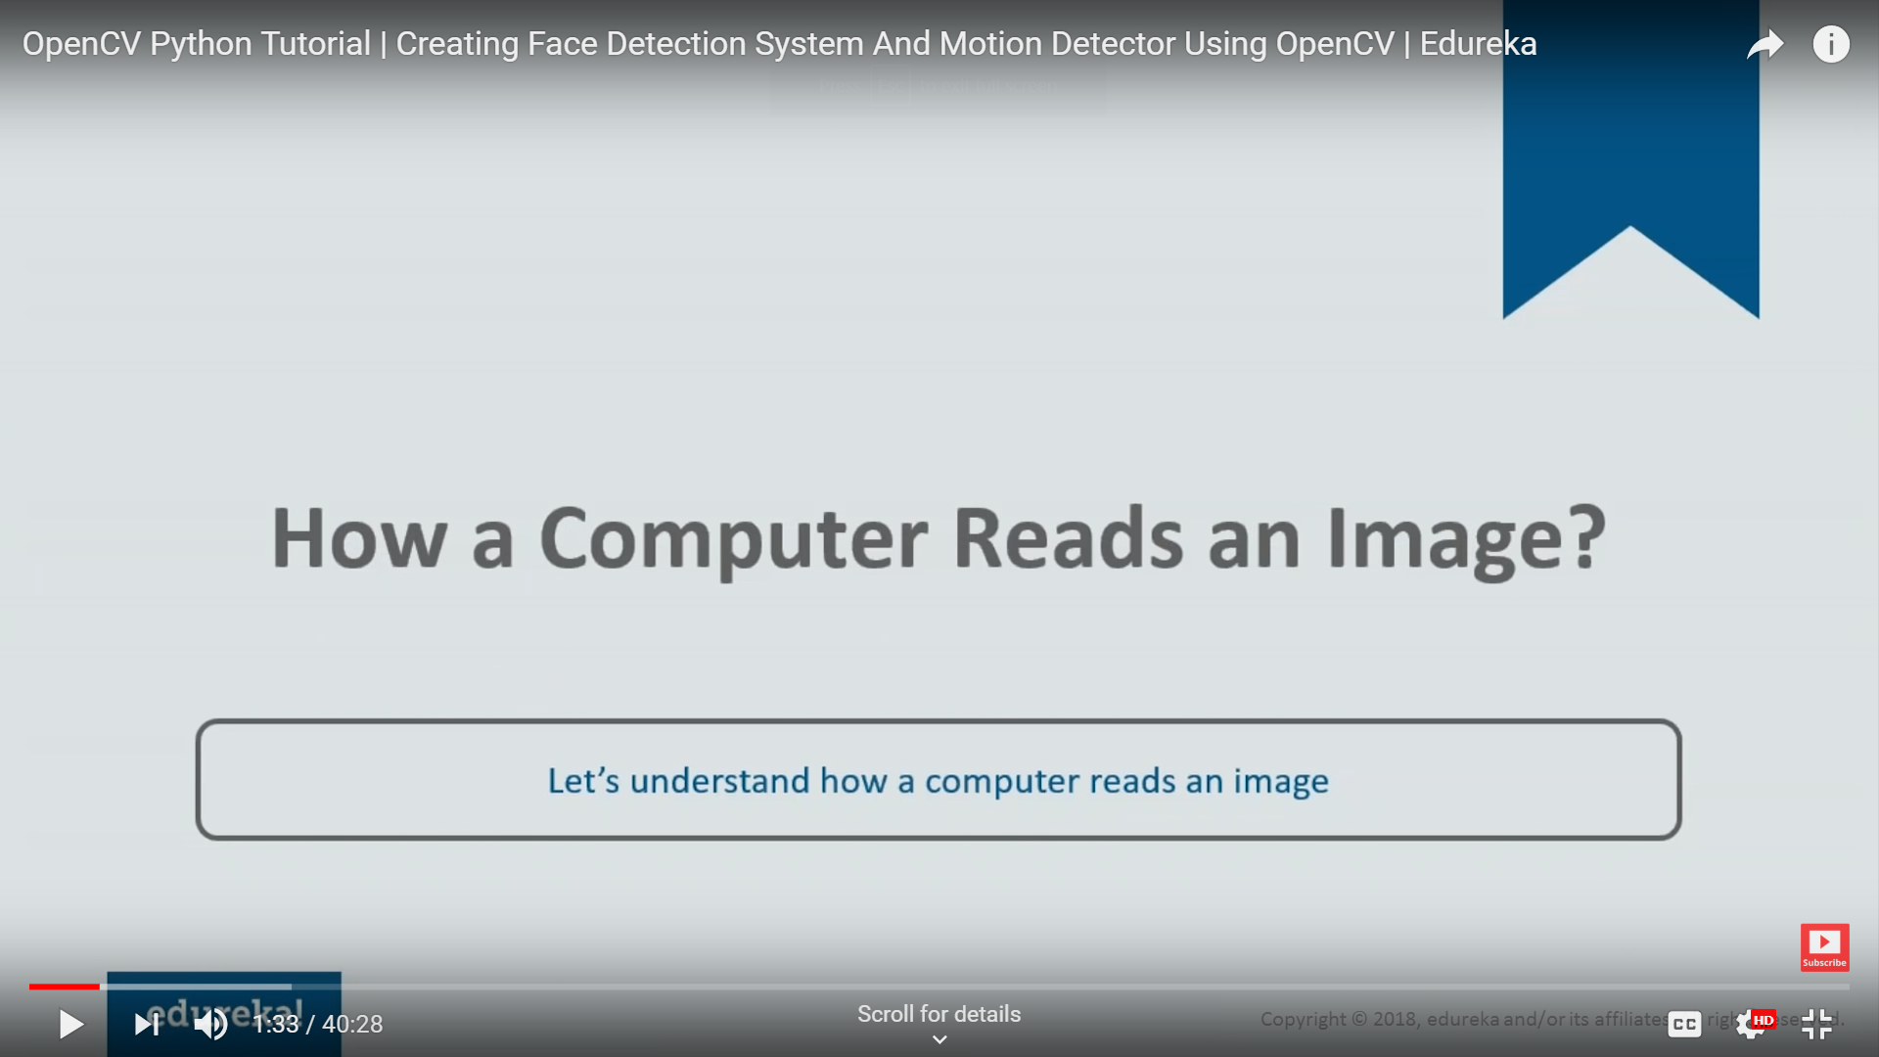
Computer Vision - How

Slide 6
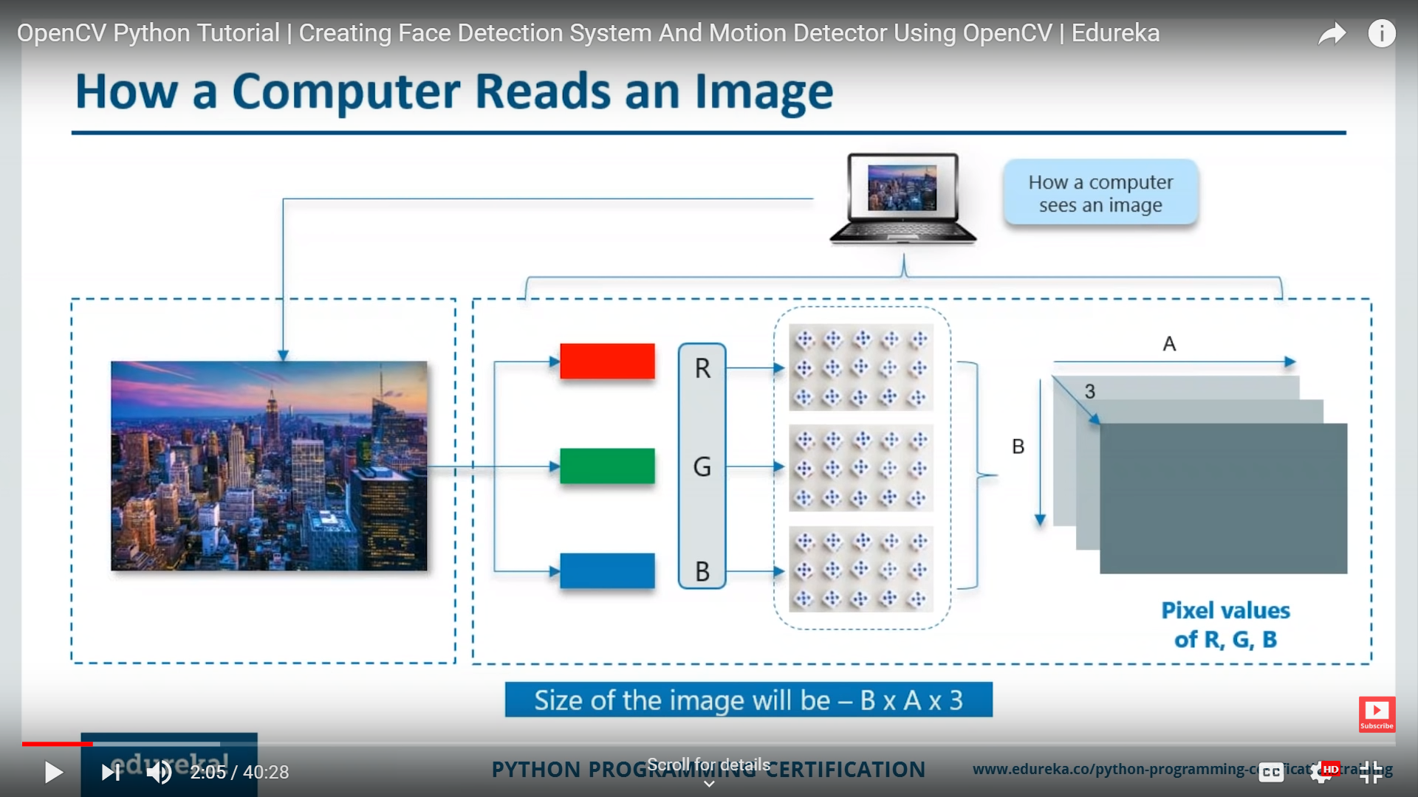
Computer Vision - How

Slide 7
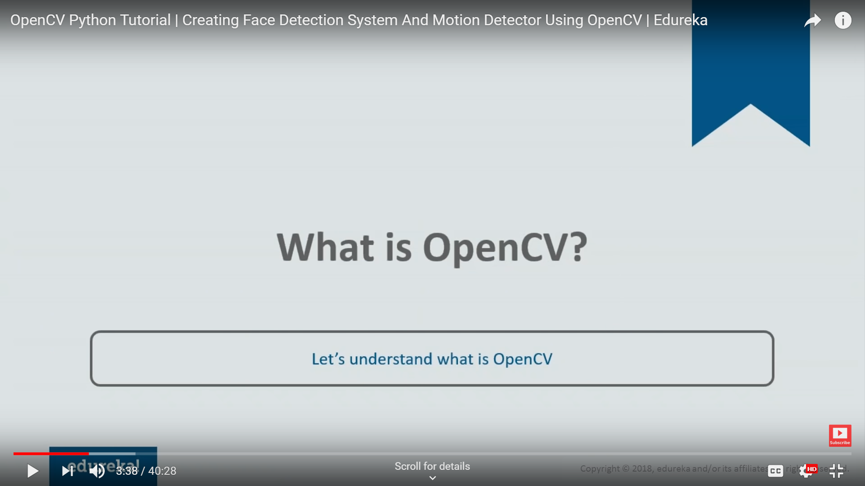
OpenCV

Slide 8
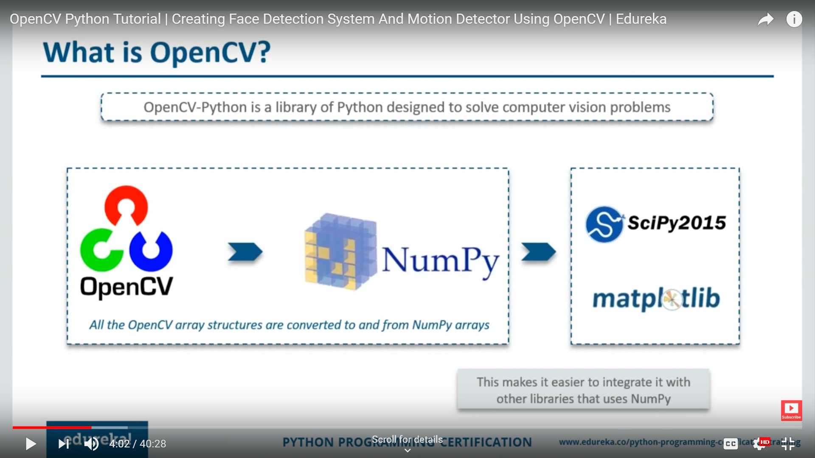
OpenCV

Slide 9
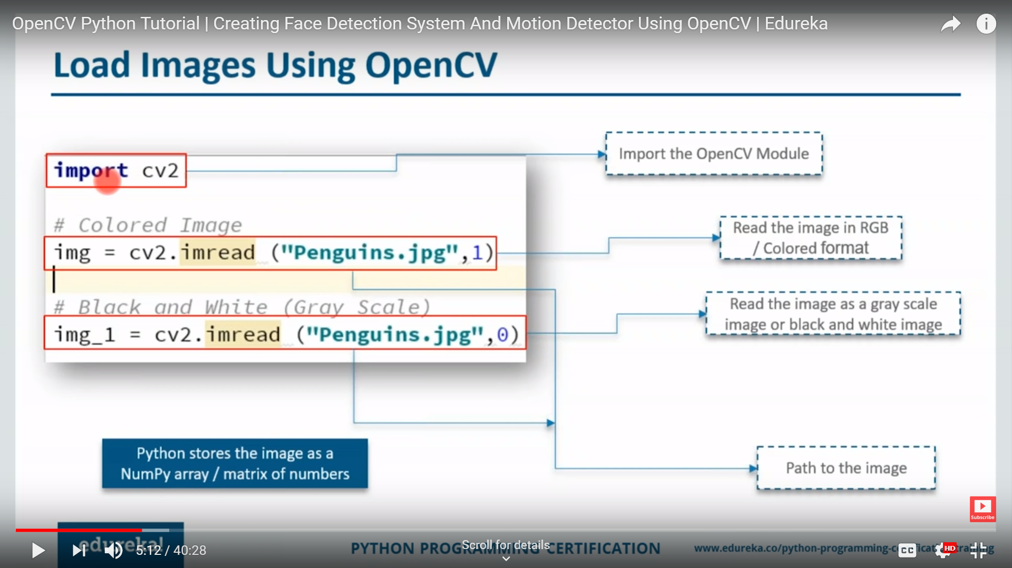
OpenCV

Slide 10
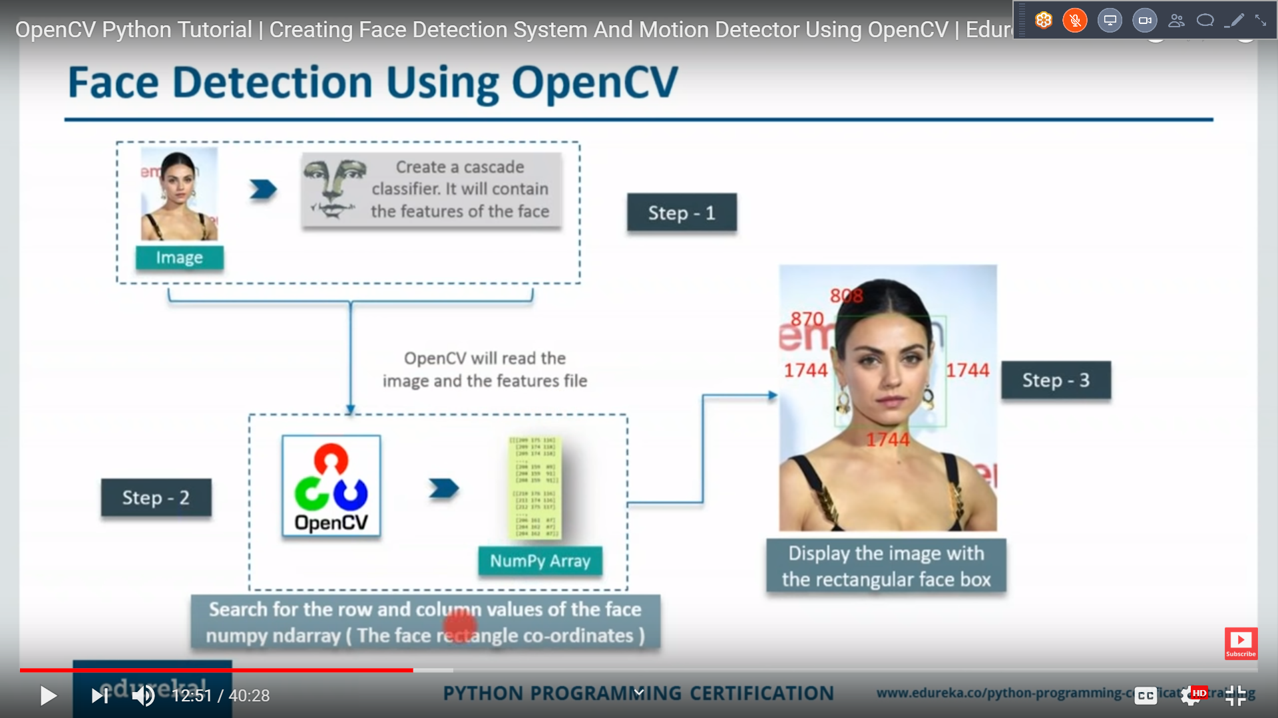
Face Detection

Slide 11
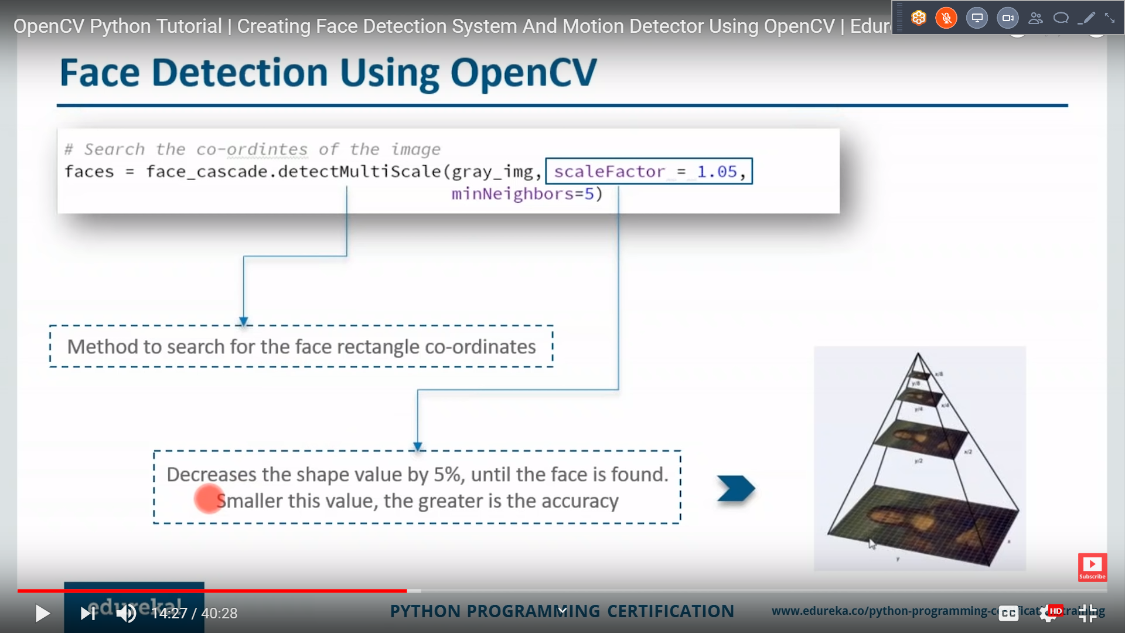
Face Detection - OpenCV

Slide 12
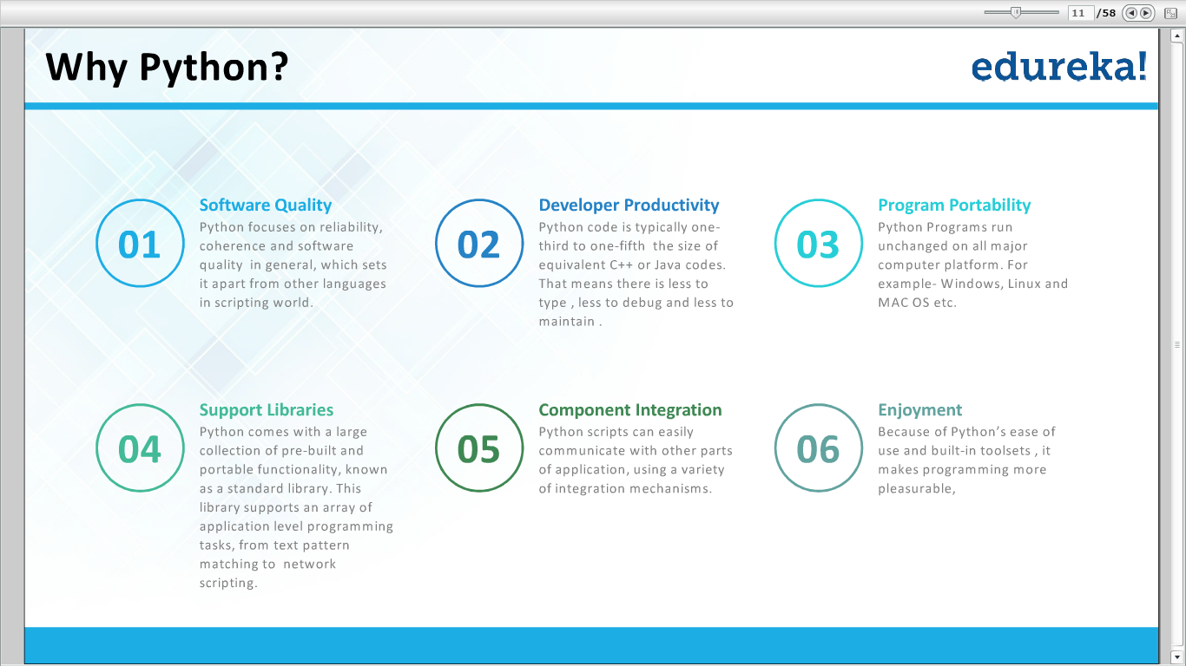

Slide 13
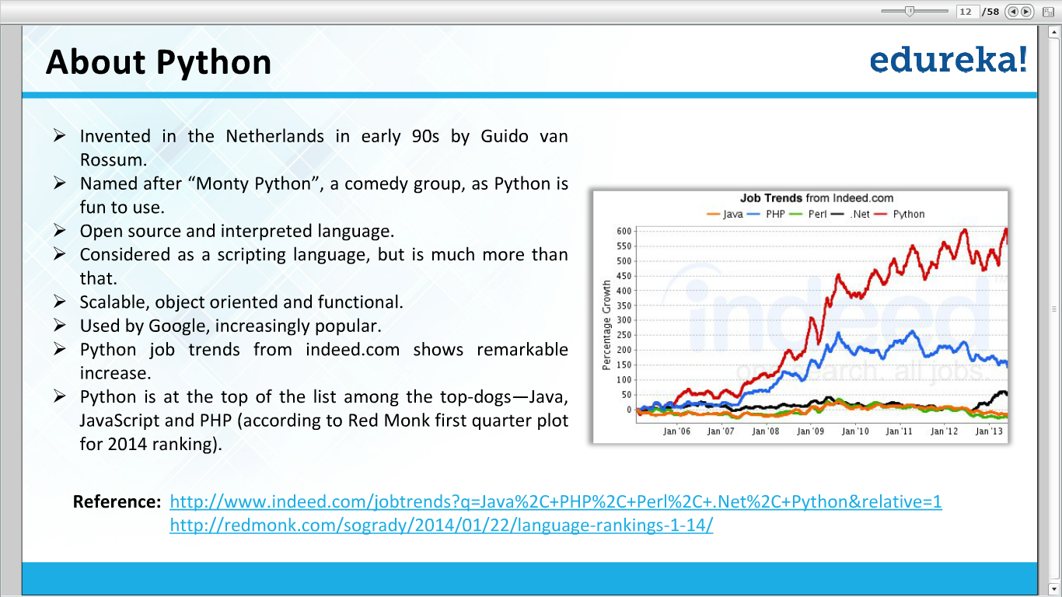

Slide 14
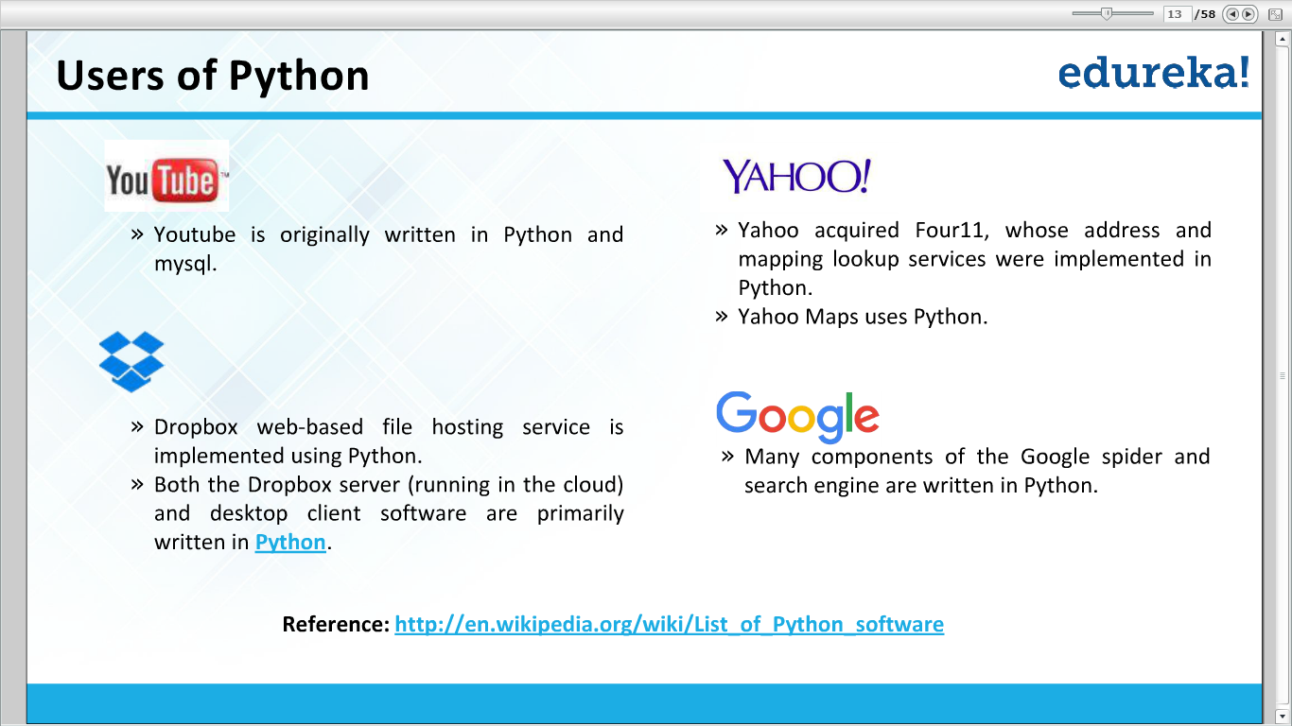

Slide 15
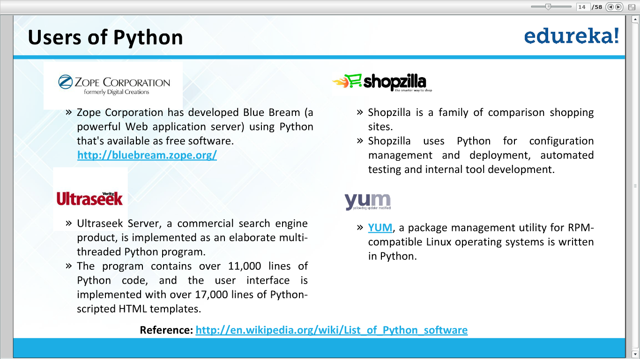

Slide 16
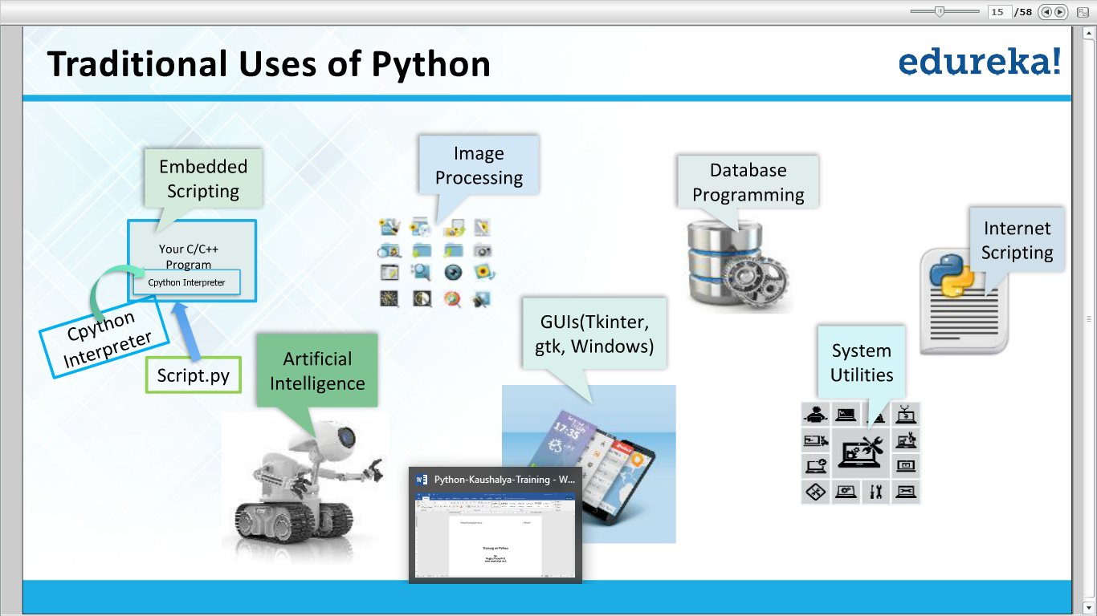

Slide 17
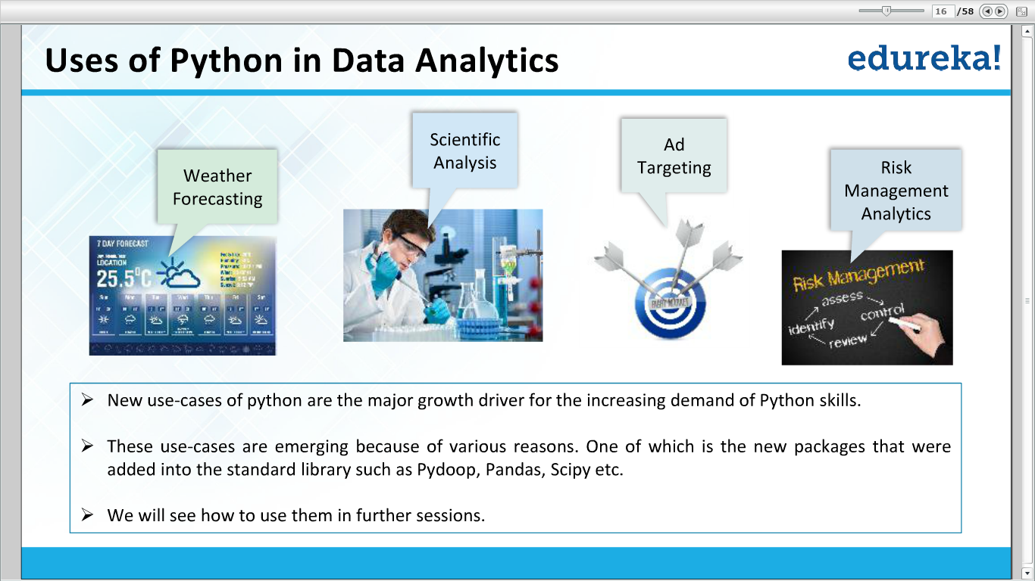

Slide 18
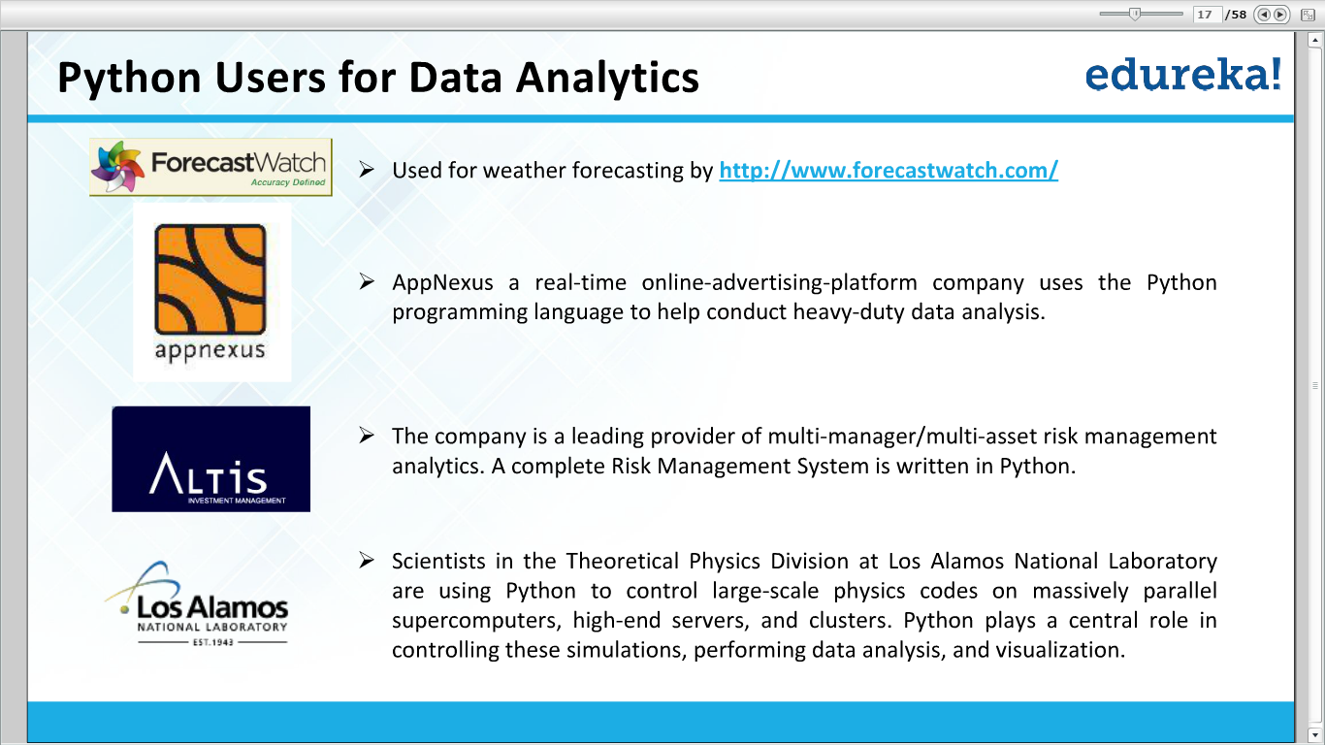

Slide 19
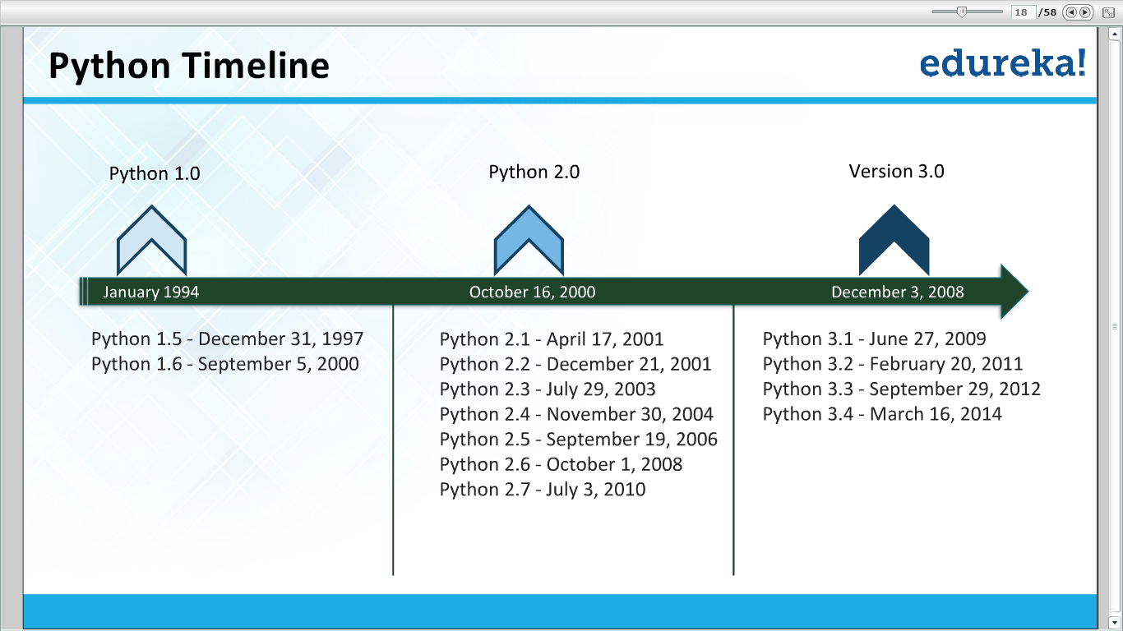

Slide 20
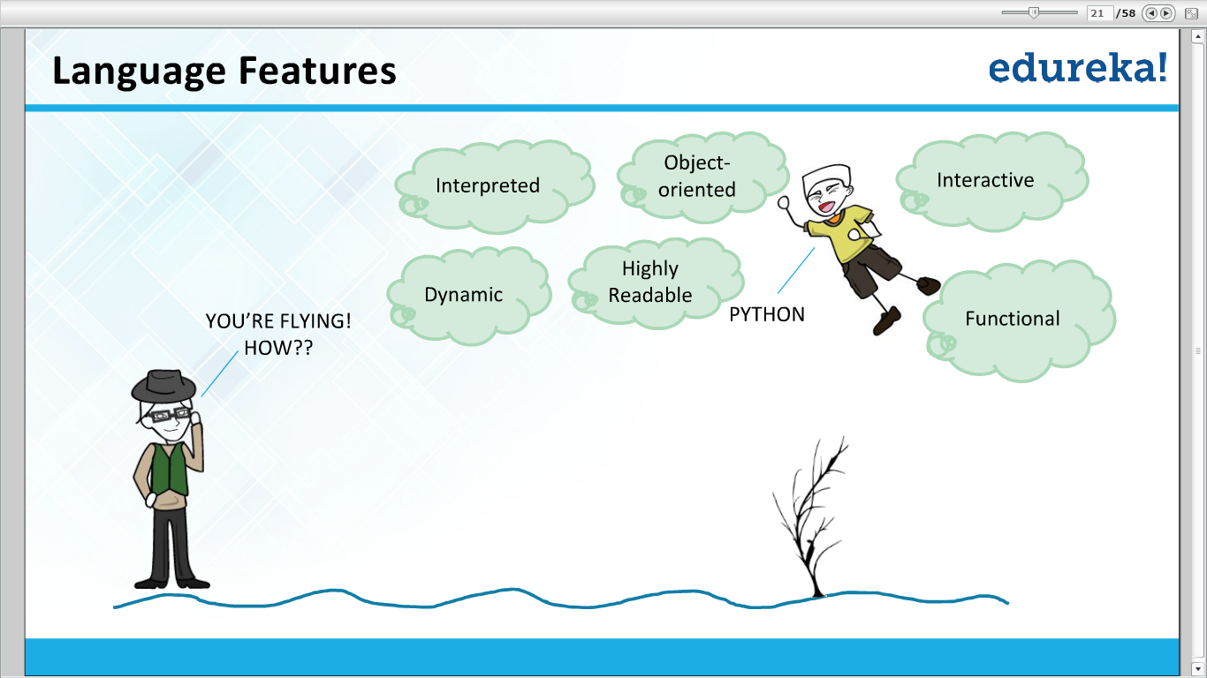

Slide 21
Thank You

